Slide 1
HTT splicing enhancer on-target and off-target effects
Aug 16, 2022
RDS Group Meeting
Zhen, Dann, Catherine, Joon, Magnus, Jessica

Slide 2
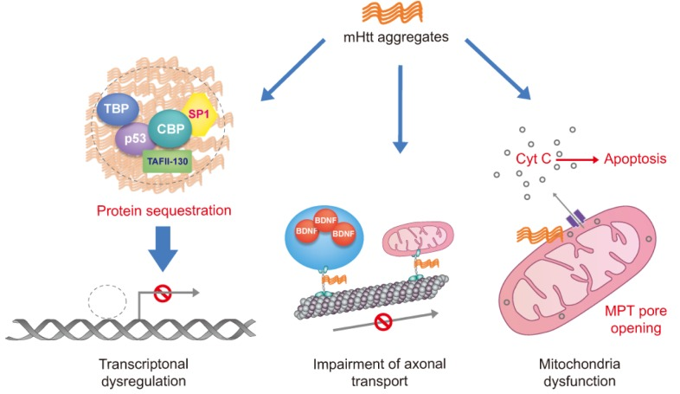
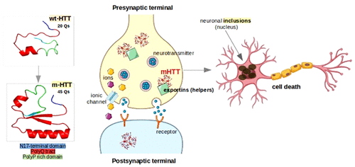
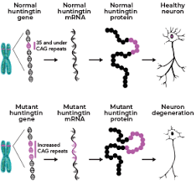
Huntingtin protein (HTT) and Huntington Diseass (HD)
(A)
(B)
(C)
mHTT is believed be responsible for Huntington’s Disease (HD)
wtHTT contains fewer (not more than 35 Qs) polyglutamine residues while mHTT has more than 35 Qs
A general assumption: short polyP domain is that it might act as an antagonist for β-sheet formation and keep HTT soluble
Plots from Sanda Nastasia et al.

Slide 3
HTT gene poison exon spicing in
Classical toxic exon splicing in type
48
49
49N
50
51
Ex49N: chr4:3,213,622-3,213,736 (+)
Nonsense-mediated mRNA decay (NMD)
By Jessica

Slide 4
TST11872 Study design
Compound | CRL HTRF IC50 (nM) | Internal HTRF IC50 (nM) | Internal iPSC qPCR IC50 (nM) | Internal NGN2 qPCR IC50 (nM) | ~3x IC50 Dose (nM) | Actual X-fold IC50 (iPSC) | Actual X-fold IC50 (NGN2) | ~10x IC50 Dose (nM) | Actual X-fold IC50 (iPSC) | Actual X-fold IC50 (NGN2) | Notes
BIO-1755497 | 121 | 4 | 10.75 | 3 | 12 | 1.12 | 4.00 | 40 | 3.72 | 13.33 | Branaplam
BIO-2006152 | 87 | 15 | 14.26 | 9.1 | 45 | 3.16 | 4.95 | 150 | 10.52 | 16.48 | ~PTC-518
BIO-2059811 | 87 | Expected <100nM | 101.5 | 65.19 | 261 | 2.57 | 4.00 | 870 | 8.57 | 13.35 | PTC different core
BIO-2135644 | 100 | Expected <100nM | 81.68 | 68.31 | 300 | 3.67 | 4.39 | 1000 | 12.24 | 14.64 | PTC different core
BIO-2136770 | 100 | Expected <100nM | 41 | 24.59 | 300 | 7.32 | 12.20 | 1000 | 24.39 | 40.67 | Close PTC518 analog
BIO-1949634 | 1500 | 6200 | 357.55 | 324.6 | 3000 | 8.39 | 9.24 | 10000 | 27.97 | 30.81 | Risdiplam
BIO-2060573 | 5780 | 670 | 298.2 | 271.5 | 3000 | 10.06 | 11.05 | 10000 | 33.53 | 36.83 | Internal lead/different core
BIO-2070692 | 560 | 50 | 140.4 | 104.4 | 1680 | 11.97 | 16.09 | 5600 | 39.89 | 53.64 | Remix example
BIO-2060884 | 370 | 240 | 77.9 | 105.9 | 3700 | 47.50 | 34.94 | 10000 | 128.37 | 94.43 | Internal lead
DMSO | - | - | - | - | - | - |  | -
Strategies for comparison:
Comp1: NGN2 ~4x
BIO-1755497 (Bran) NGN2, Low (4x)
BIO-2006152 (PTC-518) NGN2, Low (5x)
BIO-2059811 (PTC) NGN2, Low (4x)
BIO-2135644 (PTC) NGN2, Low (4.4x)
Catherine
Comp2: NGN2 ~9-16x
BIO-1755497 (Bran) NGN2, High (13x)
BIO-2006152 (PTC-518) NGN2, High (16.5x)
BIO-2059811 (PTC) NGN2, High (13.3x)
BIO-2135644 (PTC) NGN2, High (14.5x)
BIO-2136770 (PTC) NGN2, Low (12x)
BIO-1949634 (Ris) NGN2, Low (9x)
BIO-2060573 (Internal) NGN2, Low (11x)
BIO-2070692 (Remix) NGN2, Low (16x)
Comp3: iPSC ~7-10x
BIO-2006152 (PTC-518) iPSC, High (10x)
BIO-2059811 (PTC) iPSC, High (8.5x)
BIO-2135644 (PTC) iPSC, High (12.2x)
BIO-2136770 (PTC) iPSC, Low (7x)
BIO-1949634 (Ris) iPSC, Low (9x)
BIO-2060573 (Internal) iPSC, Low (10x)
BIO-2070692 (Remix) iPSC, Low (12x)
Comp4: iPSC ~2-4x
BIO-1755497 (Bran) iPSC, High (4x)
BIO-2006152 (PTC-518) iPSC, Low (3x)
BIO-2059811 (PTC) iPSC, Low (2.6x)
BIO-2135644 (PTC) iPSC, Low (4x)

Slide 5
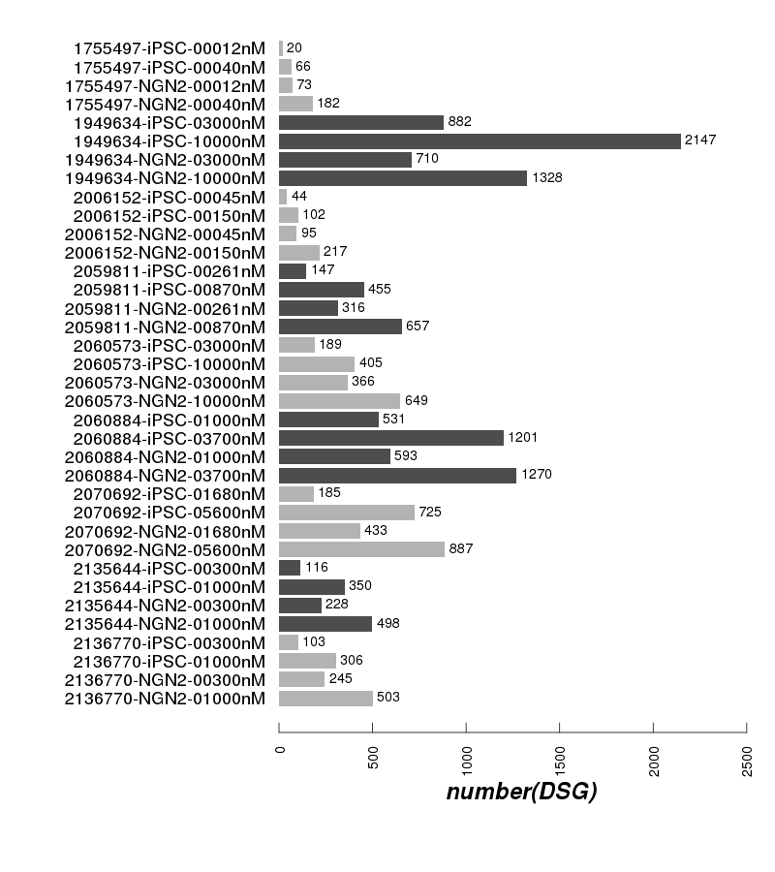
Differential spliced genes

Slide 6
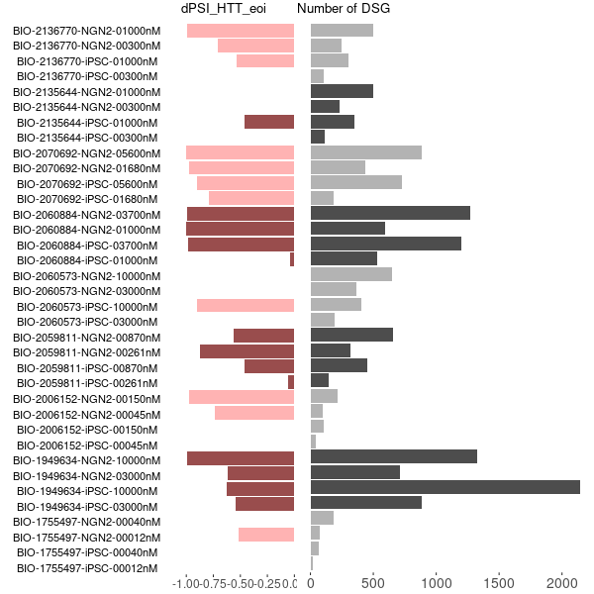
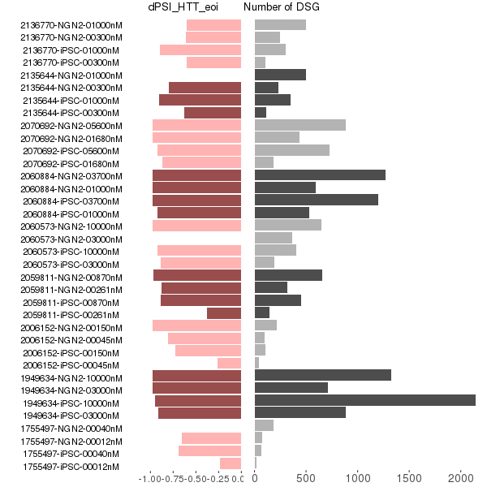
DSG and dPSI in eoi
dPSI from leafcutter
dPSI from majiq
1.00
1.00

Slide 7
Differential Algorithm
C2
48
49
49N
50
51
C1
C3
C1+C3
------------------
C1+2*C2+C3
C1
---------------
C1+C2+C3
C1
---------- +
C1+ C2
C3
---------
C2+C3
rMATS
leafcutter
majiq

Slide 8
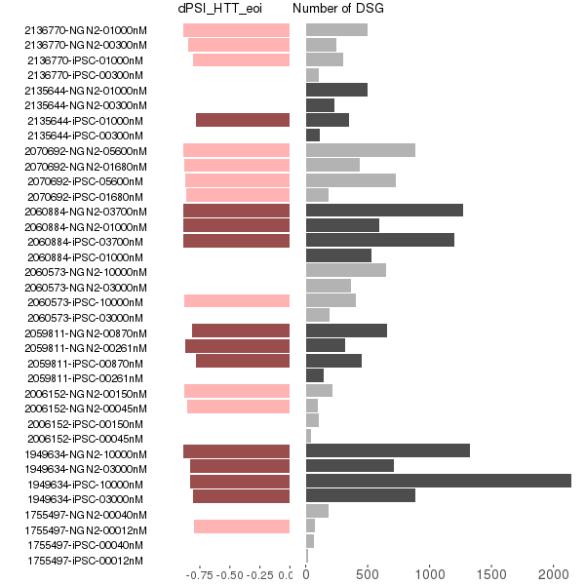
DSG and dPSI in eoi
Updated dPSI from leafcutter
dPSI from majiq

Slide 9
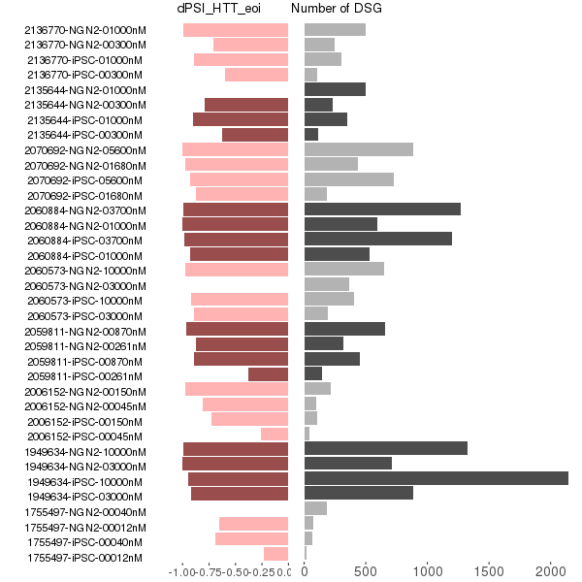
DSG and dPSI in eoi
Updated Intron_retension_rate (from leafcutter + majiq)

Slide 10
The 9 ggsashimi plots in PDF format

Slide 11
It looks more than toxic exon spicing in
Classical toxic exon splicing in type
48
49
49N
50
51
Ex49N: chr4:3,213,622-3,213,736 (+)
Non-Classical but high frequent ones
48
49
49N
Intron
50
51
Non-Classical and less frequent ones
48
49
49N
Intron
50
51
Nonsense-mediated mRNA decay (NMD)
Edited from Jessica Plots

Slide 12
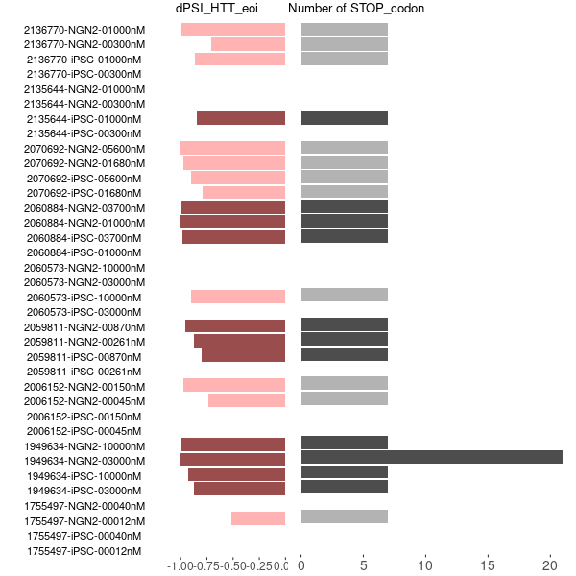
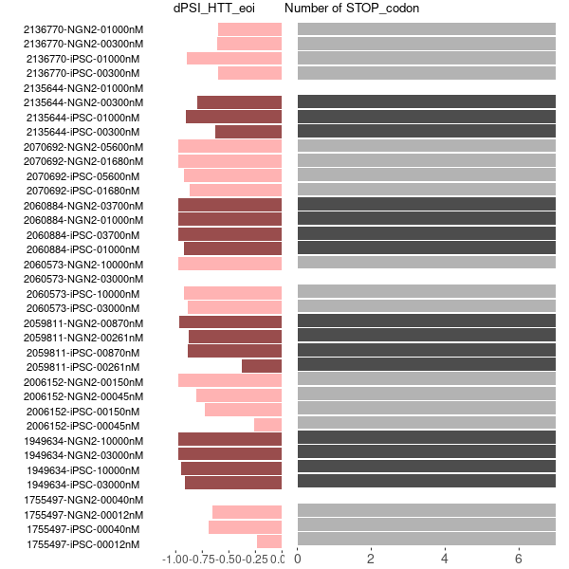
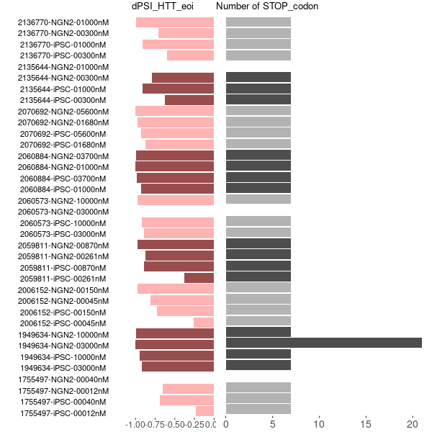
dPSI and stop_codon
from leafcutter
from majiq
merged

